Slide 1
CSS Positions
CSS Layout - The position Property

Slide 2
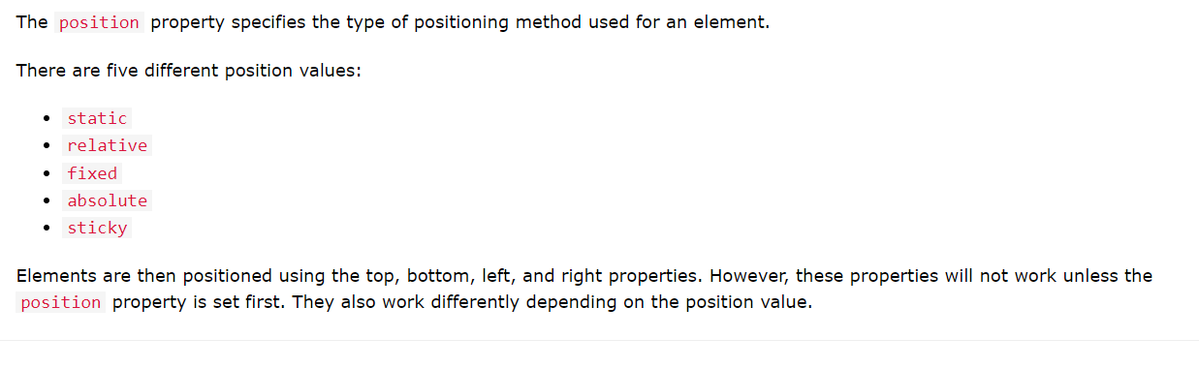
The position Property
The position property specifies the type of positioning method used for an element (static, relative, fixed, absolute or sticky).

Slide 3
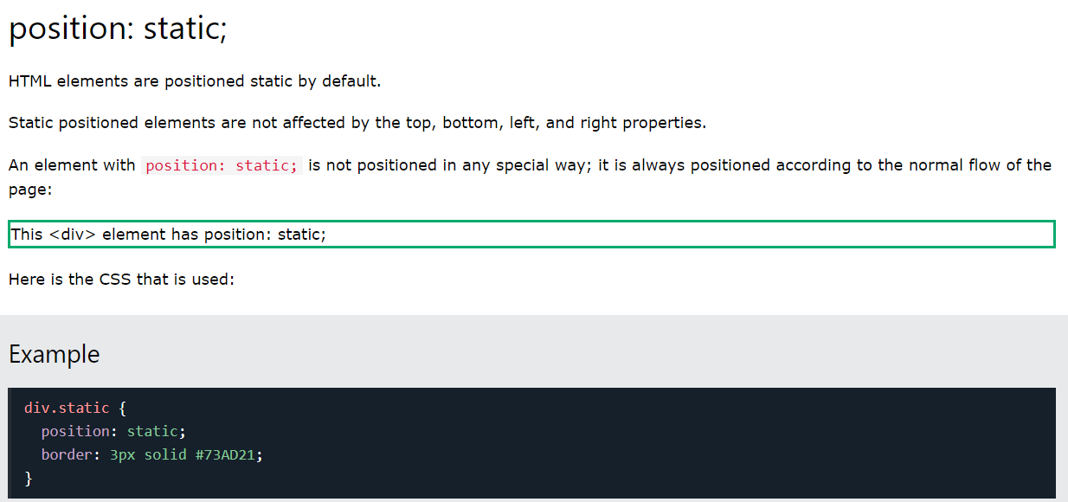
Example:

Slide 4
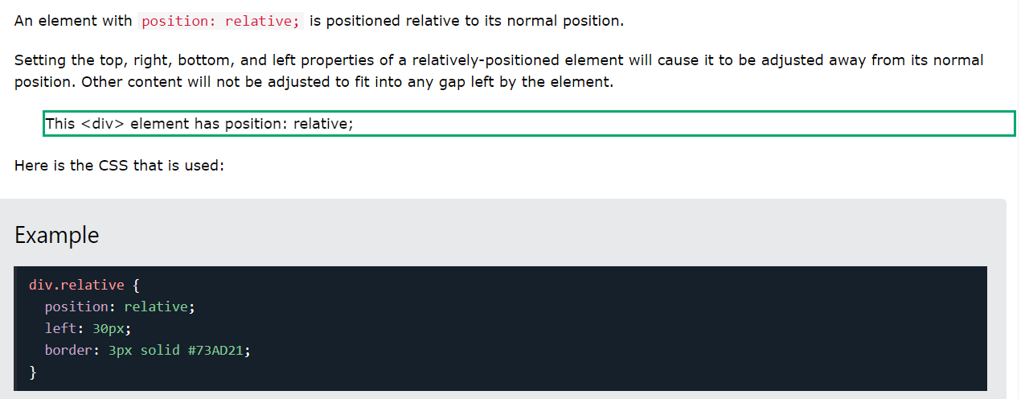
position: relative;

Slide 5
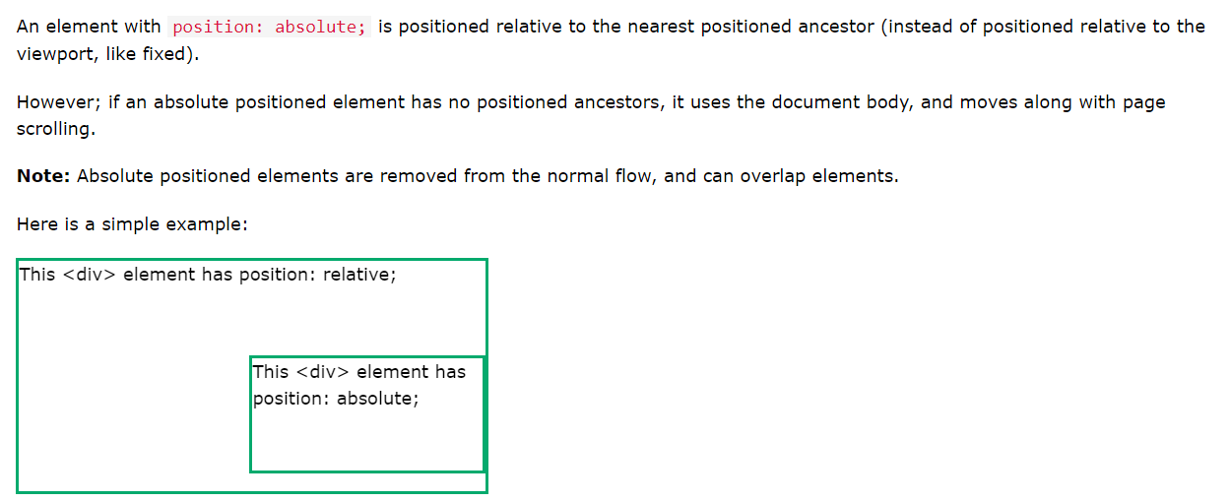
position: absolute;

Slide 6
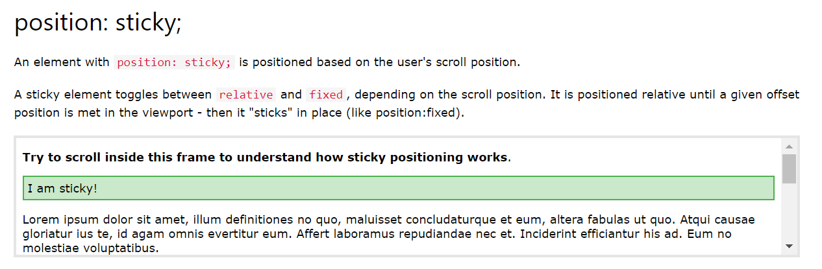
position: sticky;

Slide 7
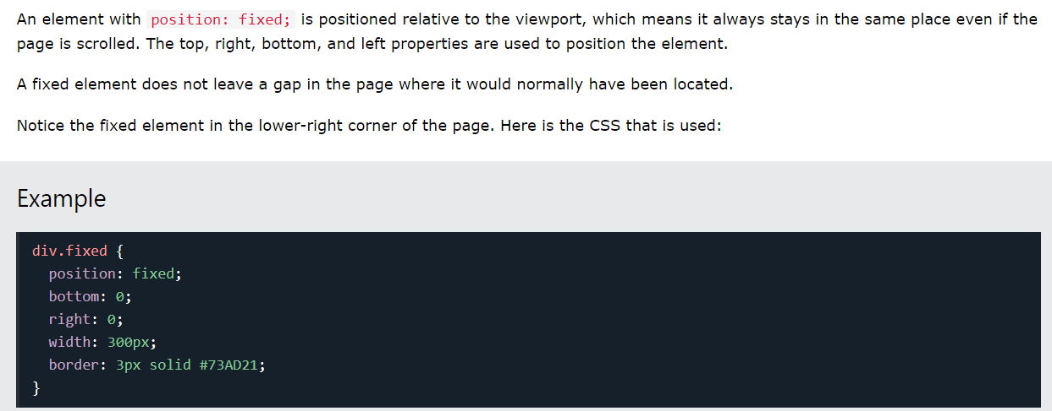
position: fixed;

Slide 8
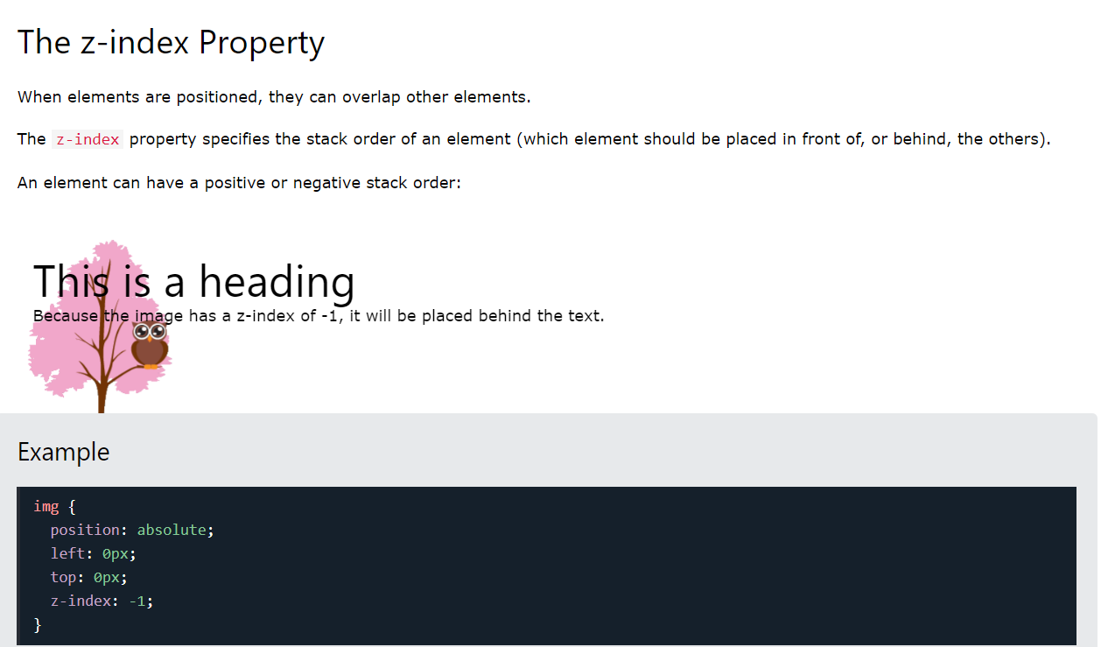
CSS Layout - The z-index Property
The z-index property specifies the stack order of an element.

